Slide 1
GOOGLE PLAY STORE APPLICATIONS
NAME: Satya Kireet
REGNO: 11602210
SECTION: KEM39
Roll No.: A11
COURSE CODE: INT 217

Slide 2
INTRODUCTION
Google play is a digital distribution service operated and developed by google. It serves as the official app store for the Android operating system, allowing users to download and install the applications developed with the Android software development kit (SDK) and published through google.
Google play also serves as a digital media store, offering music, magazines, books, movies and television programes.

Slide 3
CONTENTS OF GOOGLE PLAY STORE APPS
Apps
Category
Rating
Reviews
Size
Installs
Type
Price
Content rating
genres
Last updated
Current version
Android version

Slide 4
Specific Requirements, functions and formulas
We use different formulas for data cleaning, data processing and modelling.
Main function of excel that I have used are
Pivot table.
Hyper links.
Conditional formatting.
Create graph using power pivot.
Create relation between different table.
Function analyser (Slicer).
Different types of graph.
Different functionality of graph.
Creation of an attractive DASHBOARD.

Slide 5


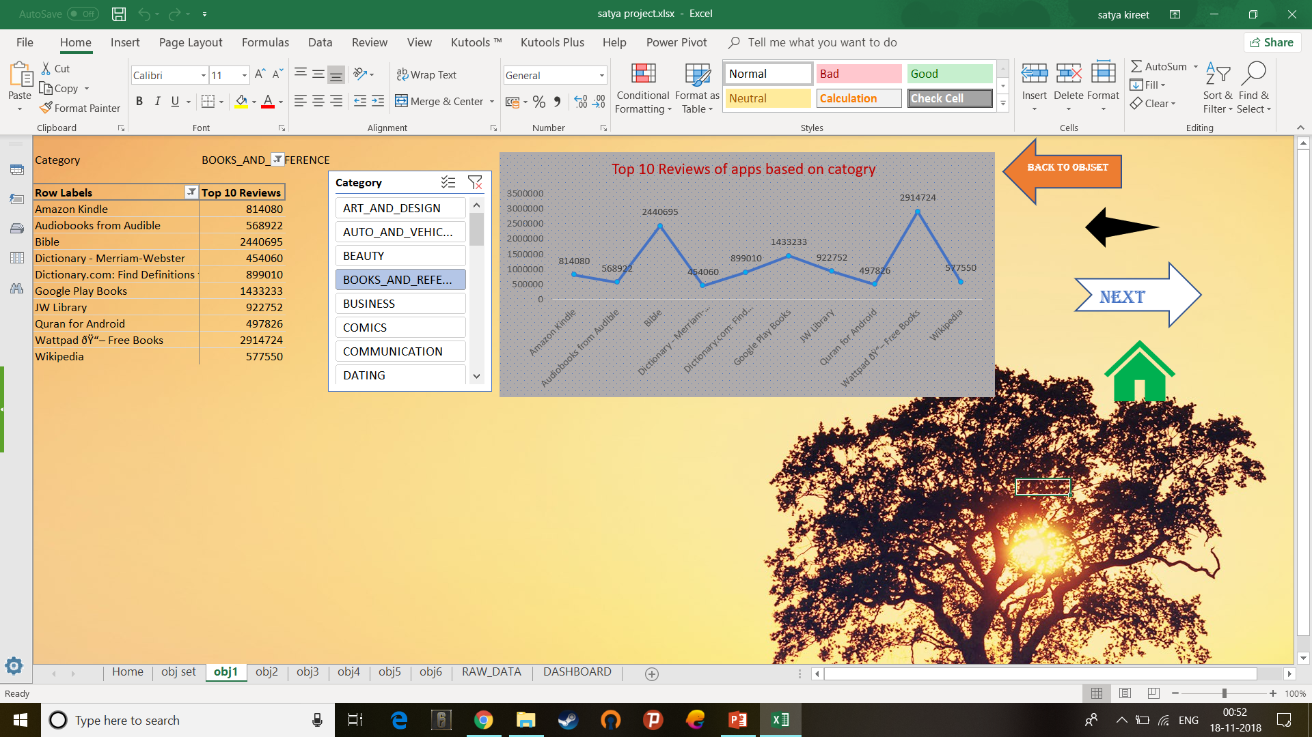

Analysis Results: Objective 1:
This analysis helps in finding the reviews of applications based on the category.

Slide 6


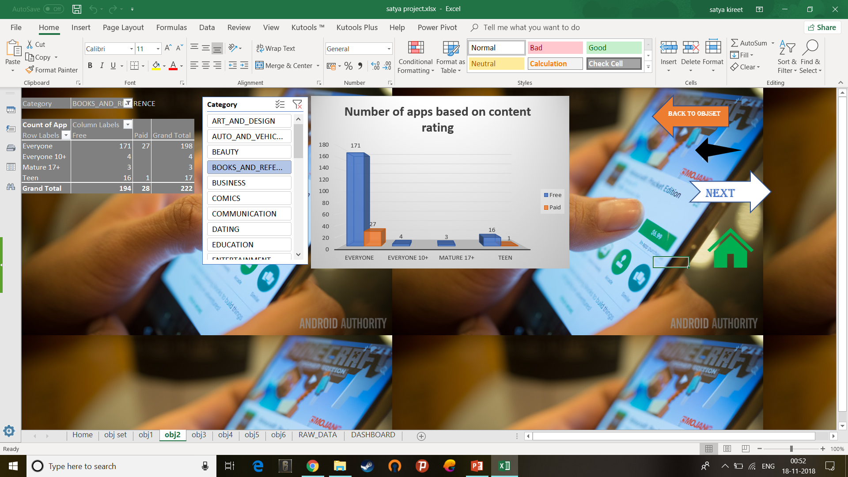

Objective 2:
This analysis helps in finding the number of applications based on the content rating.

Slide 7
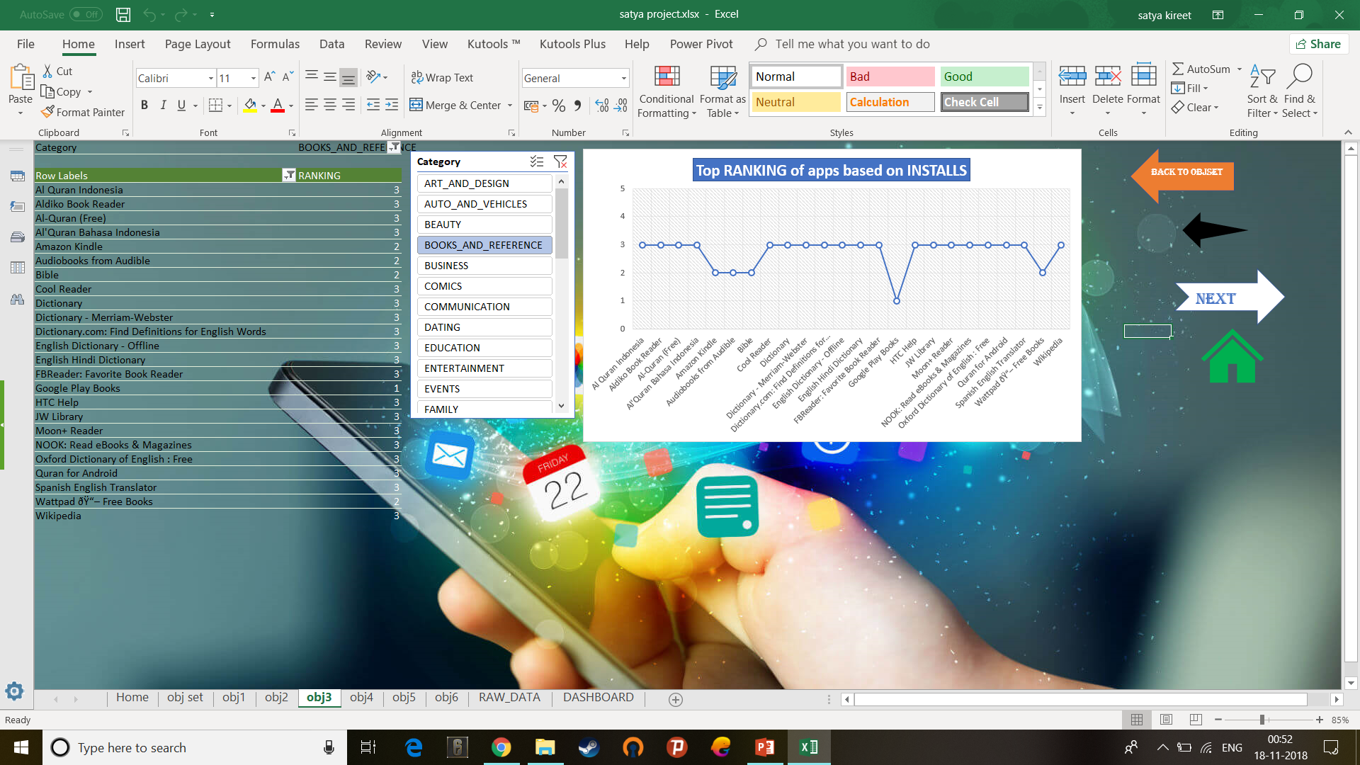
Objective 3:
This analysis helps in finding the rank of applications based on the installs of the app.

Slide 8
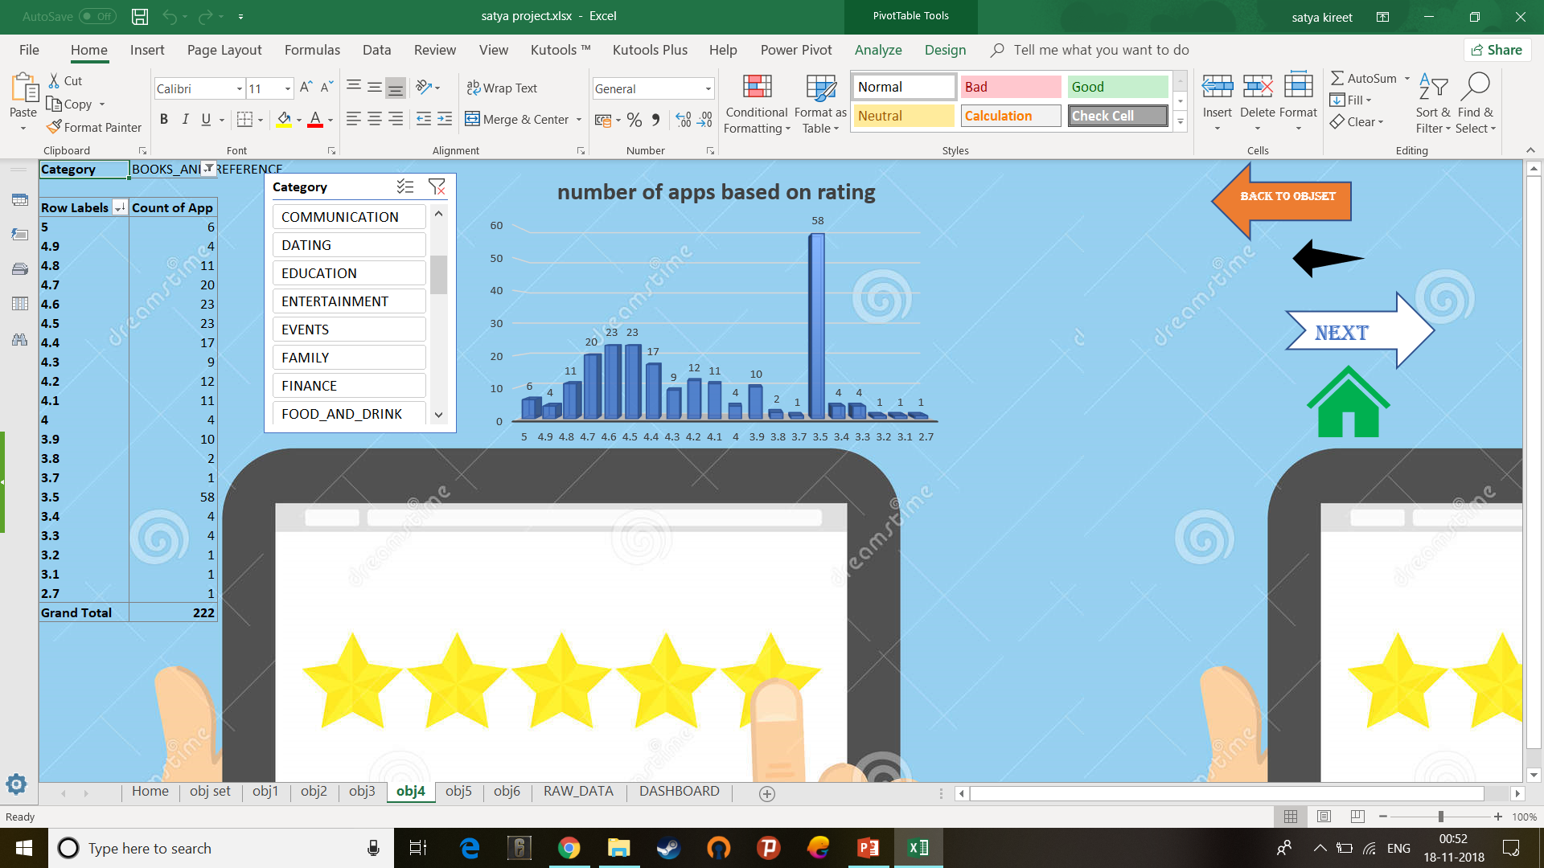
Objective 4:
This analysis helps in finding the number of applications based on the rating of the app.

Slide 9
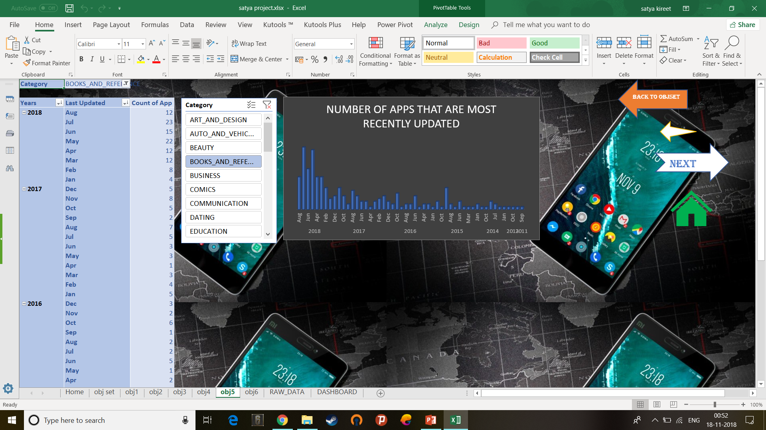
Objective 5:
This analysis helps in finding the last update of applications based on the last update column given in raw data.

Slide 10
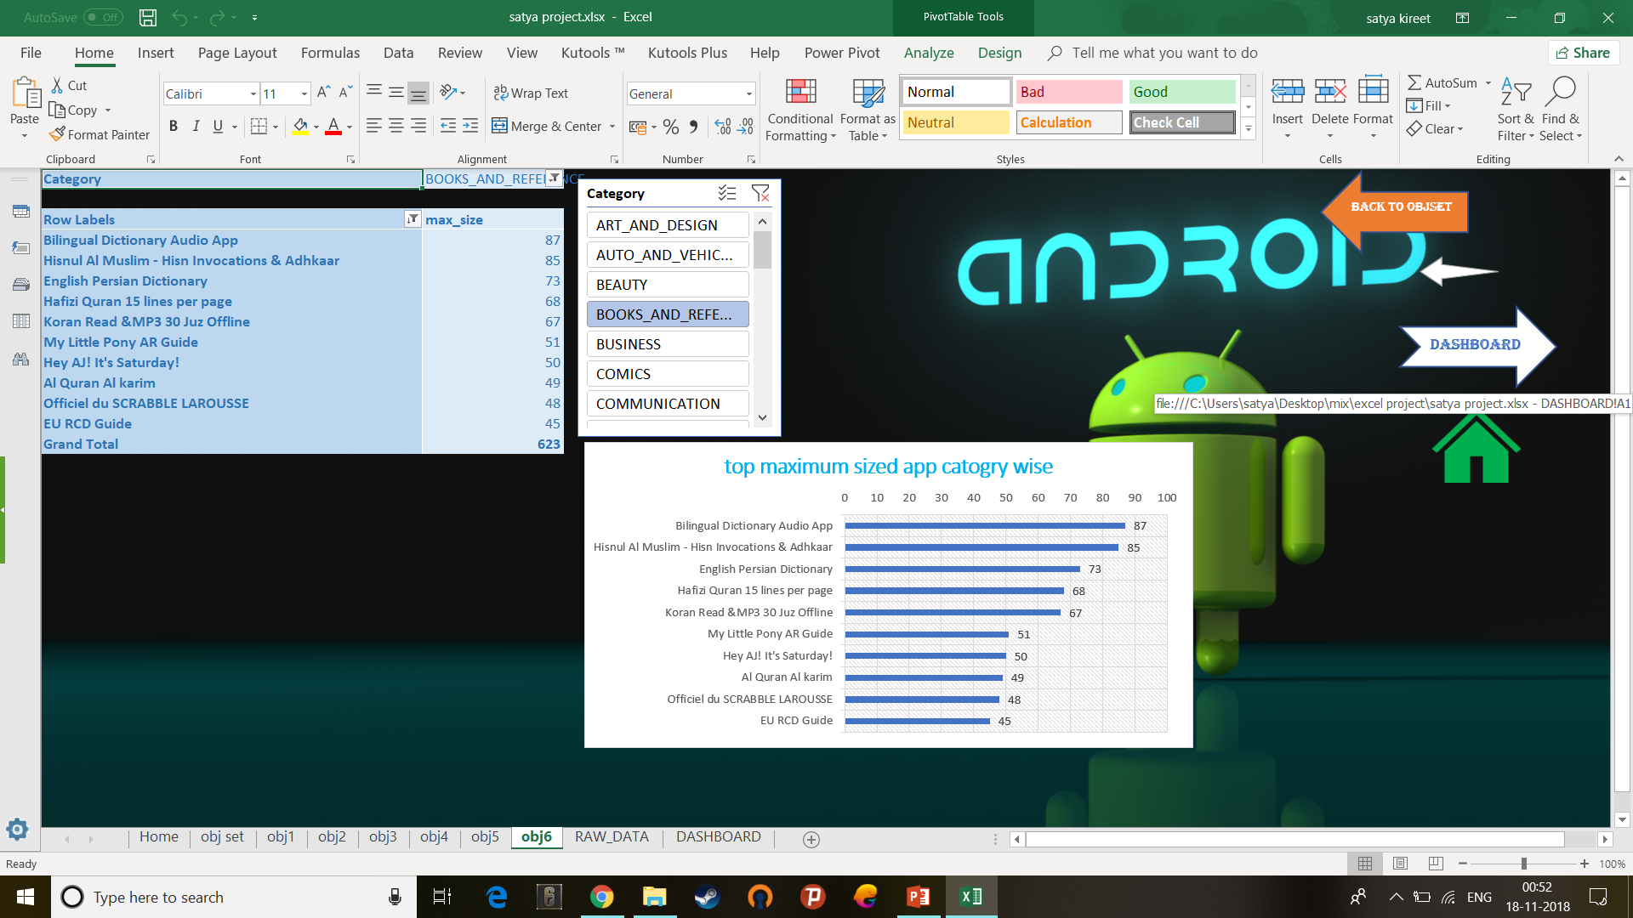
Objective 6:
This analysis helps in finding the max size of applications based on the category.

Slide 11
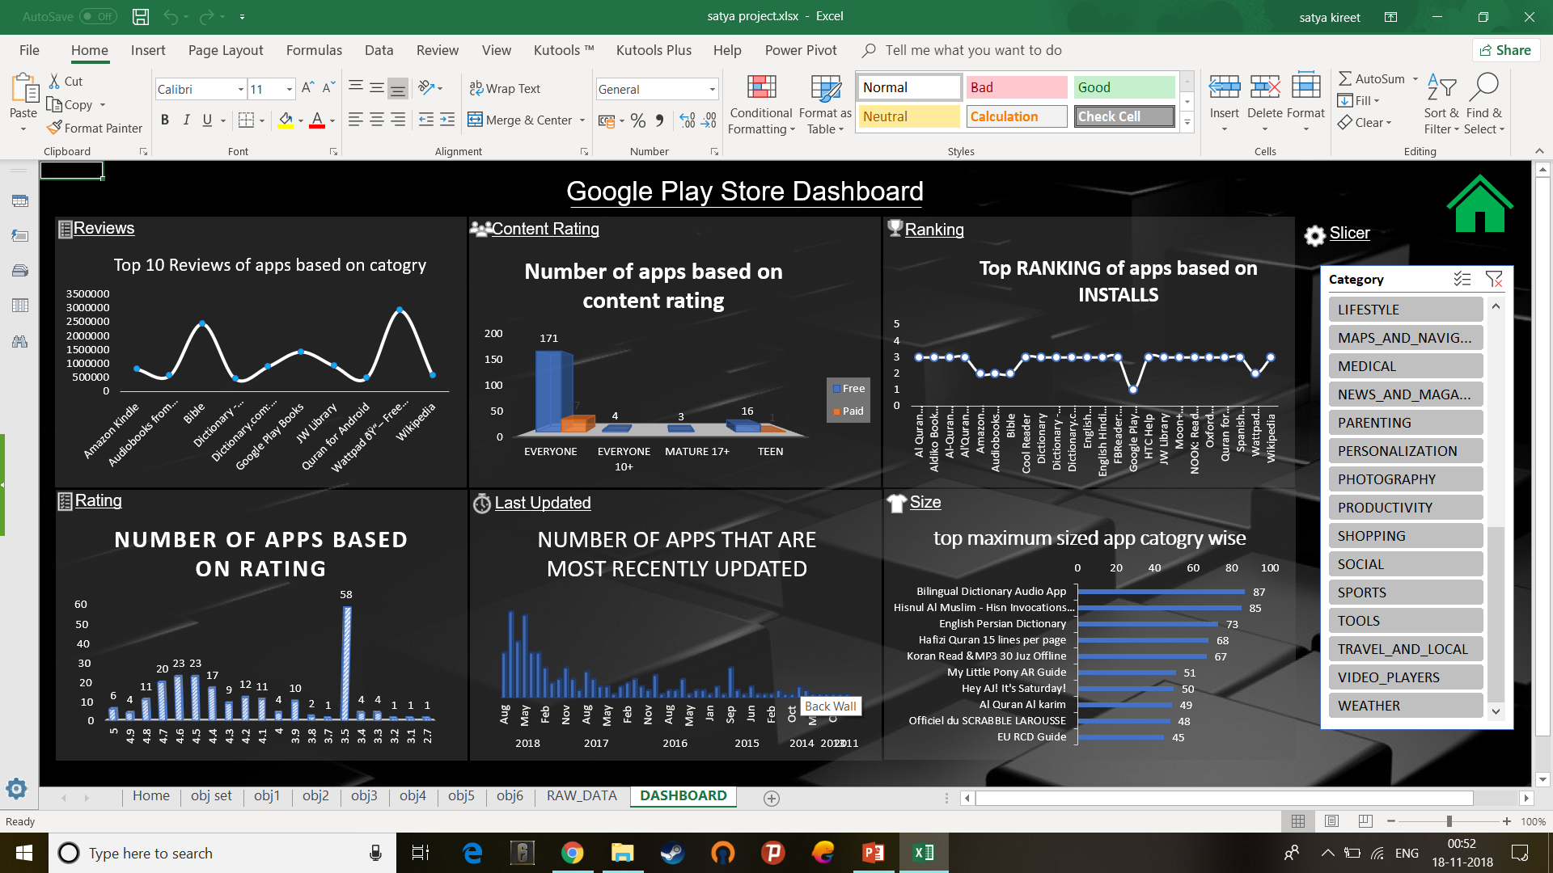

Slide 12
THANK YOU

